Slide 1
Linux/Unix
Learning

Slide 2

目录
讲什么
1
重要概念
2
常用命令和操作
推荐学习：
鸟哥的linux私房菜
3
环境配置与操作与人生经验

Slide 3
1
重要概念
Something about Linux & Unix

Slide 4
Introduction
What is Unix?
Linux VS Unix?
An operating system
Unix was the predecessor
Developed at AT&T Bell Labs in the 1960’s
Linux is a variant of Unix, or Unix-like.
Command Line Interpreter
Linux is portable and open source
GUIs (Window systems) are now available
Most of servers are running the Linux OS

Slide 5
Introduction
Why Linux?
Linux is Free
Necessary in learn & research
Fully customizable
Deploy & use servers
Quite stable
Improve your skills
Choice for programmers and scientists

Slide 6
2
常用命令和操作
Connection, shell, command etc.

Slide 7
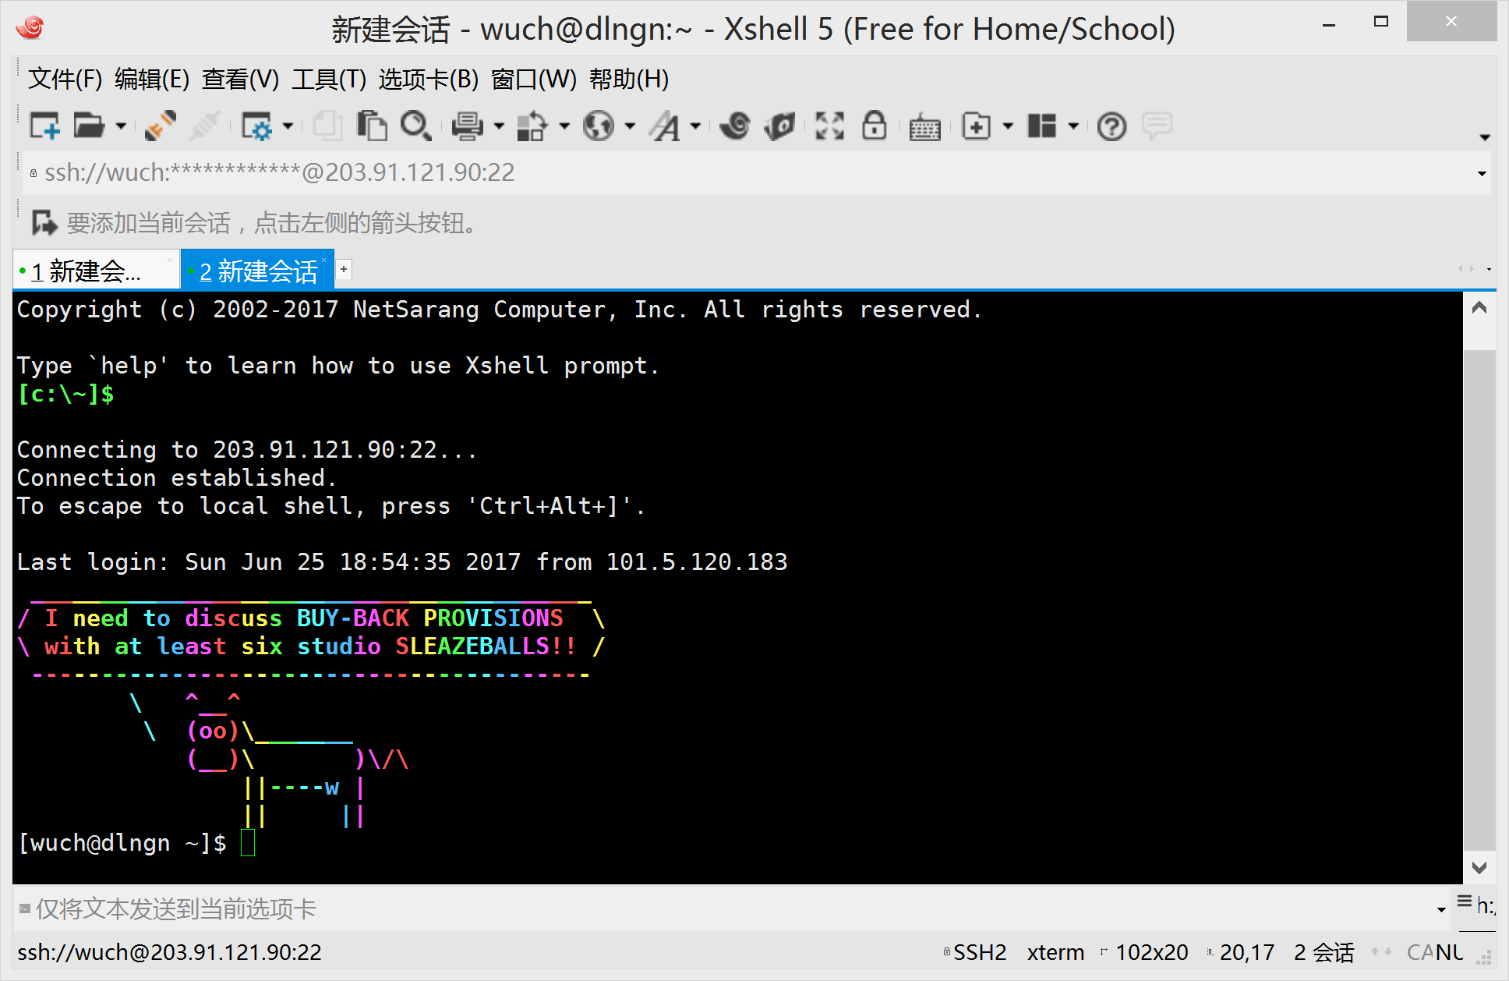
CONNECTING TO A LINUX SYSTEM

Slide 8
CONNECTING TO A LINUX SYSTEM
WHAT EXACTLY IS A “SHELL”?
After logging in, Linux/Unix starts another program called the shell.
• The shell interprets commands the user types and manages their execution
• The shell communicates with the internal part of OS called the kernel
• The most popular shells are: tcsh, csh, korn, and bash
• The differences are most times subtle
• For this tutorial, we are using bash
• Shell commands are CASE SENSITIVE

Slide 9
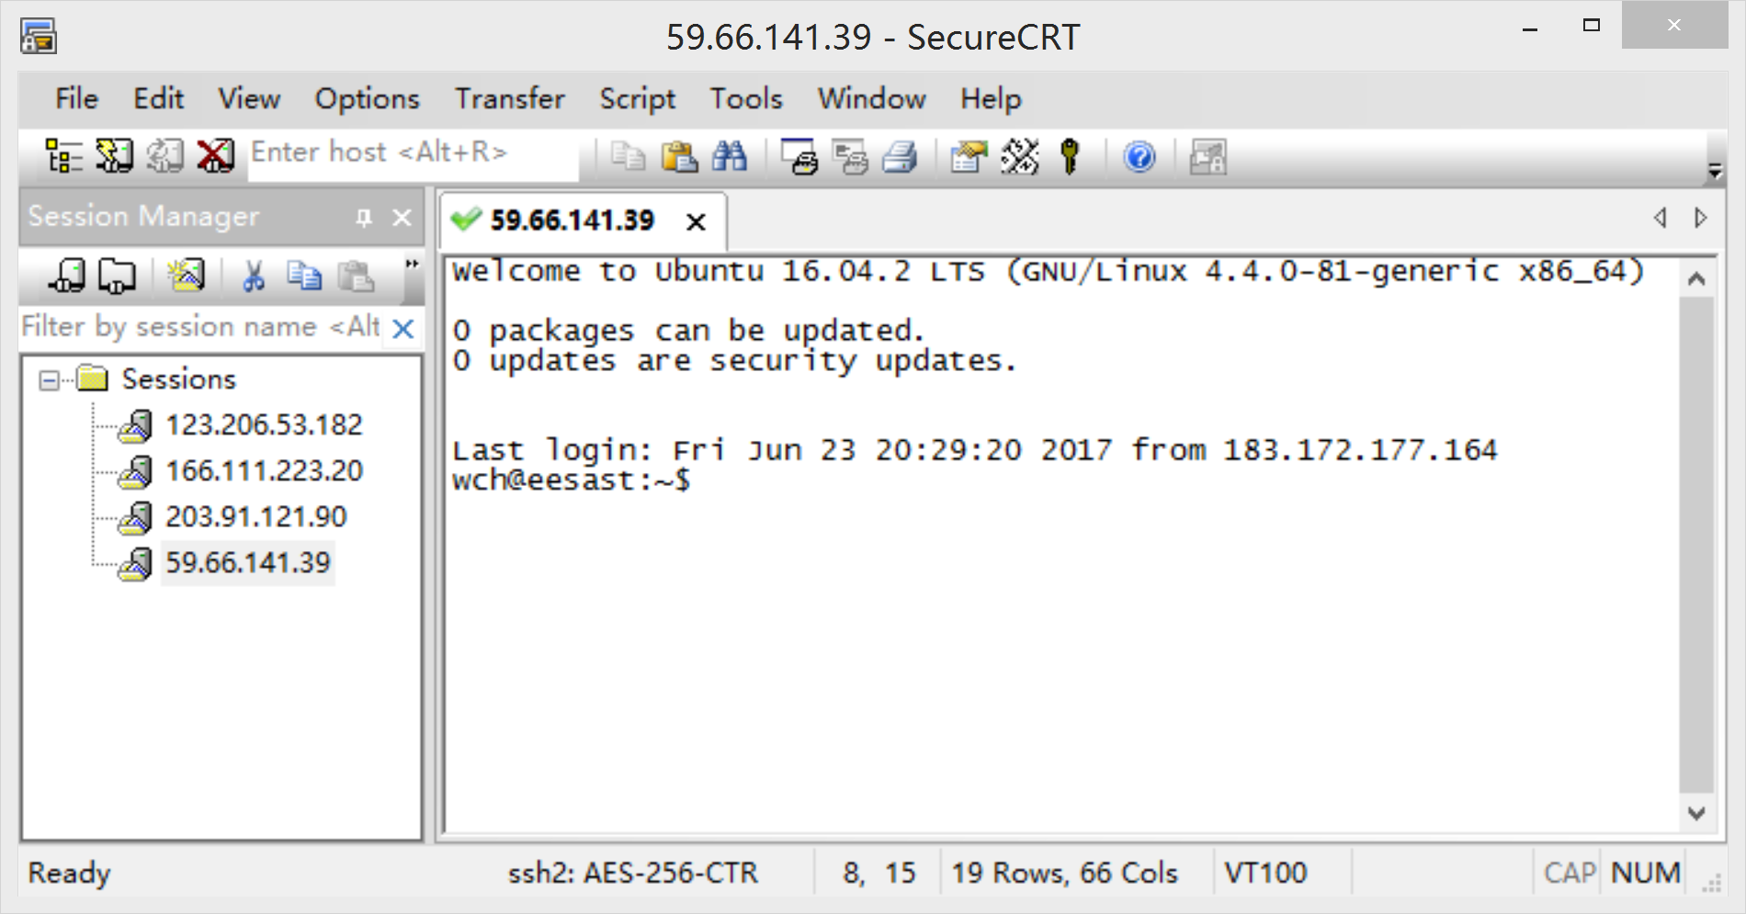
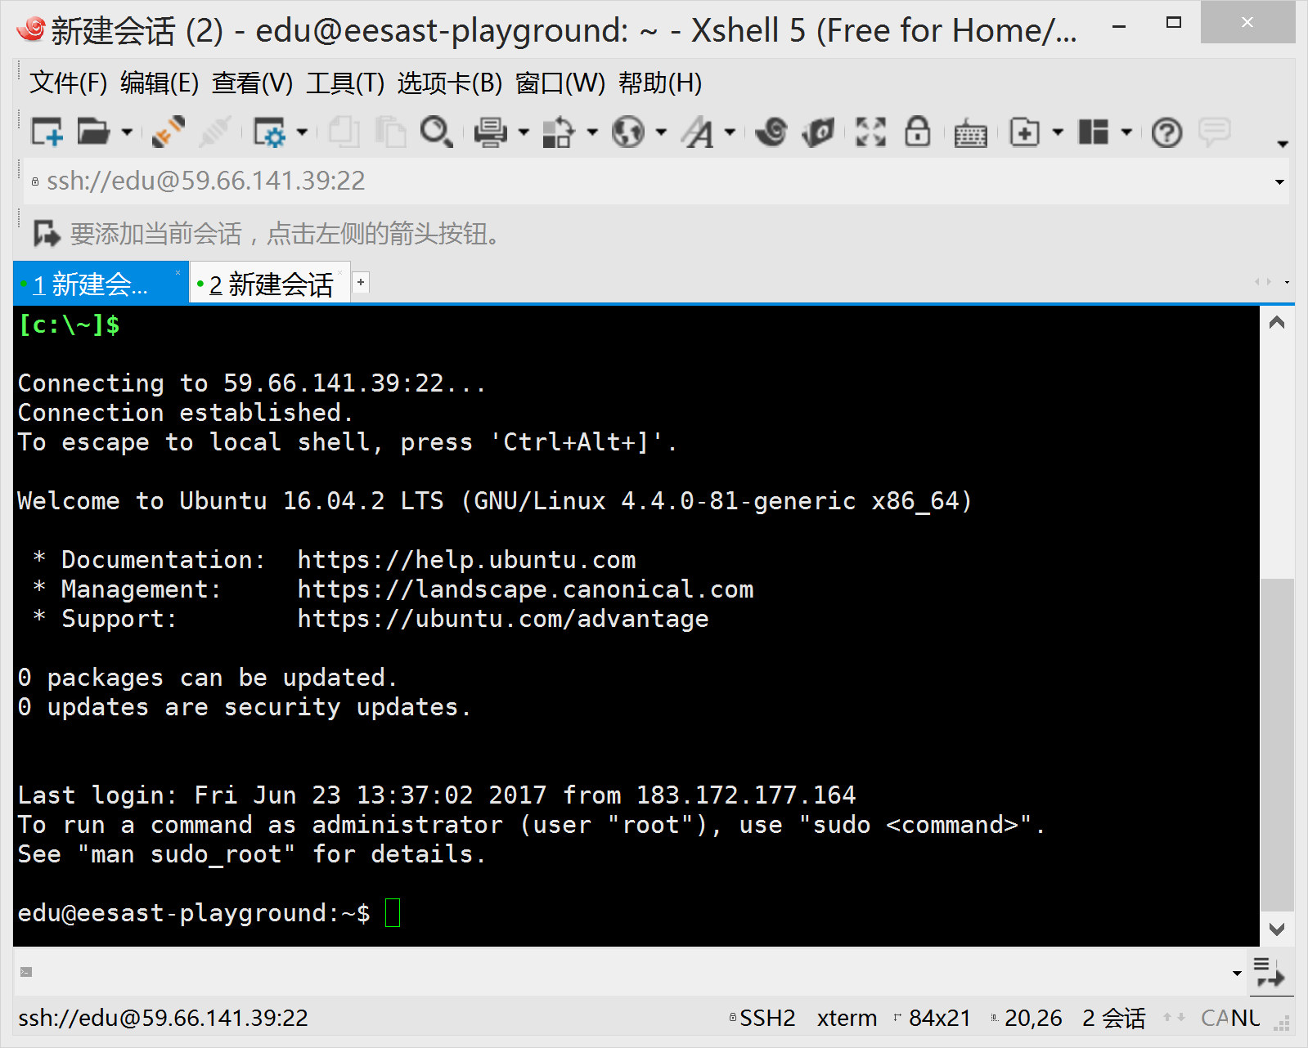
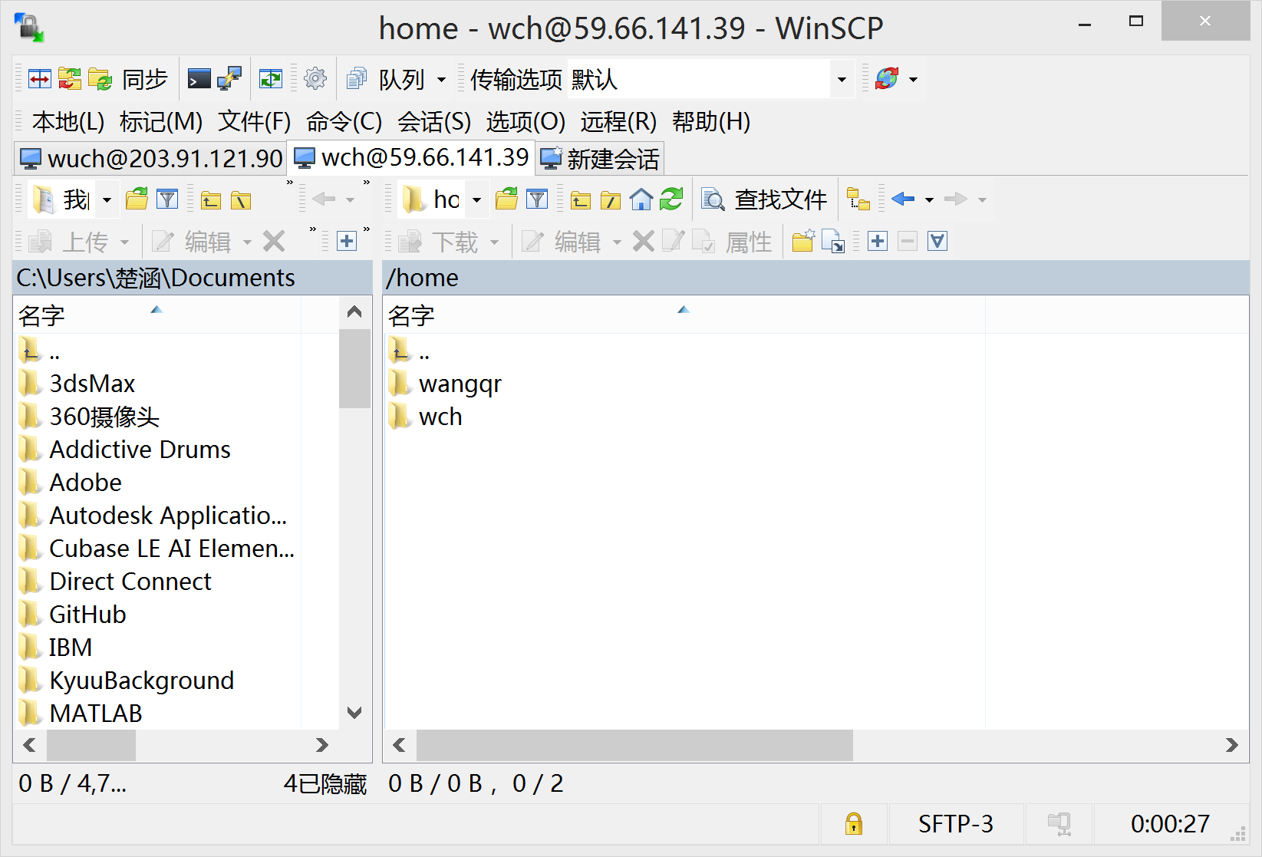
CONNECTING TO A LINUX SYSTEM
SSH connection tools
SecureCRT Xshell winscp
But DON’T use Putty!!!

Slide 10
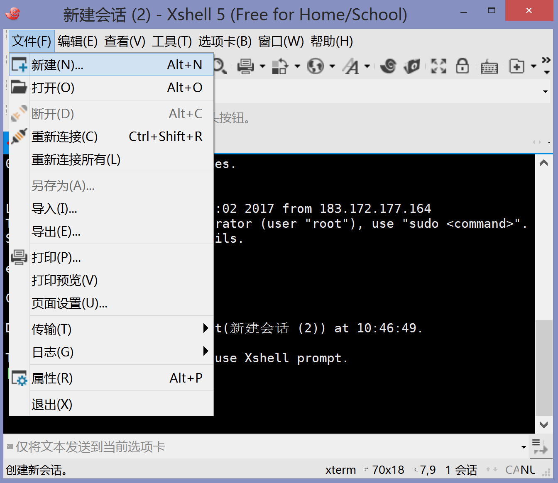
CONNECTING TO A LINUX SYSTEM

Slide 11
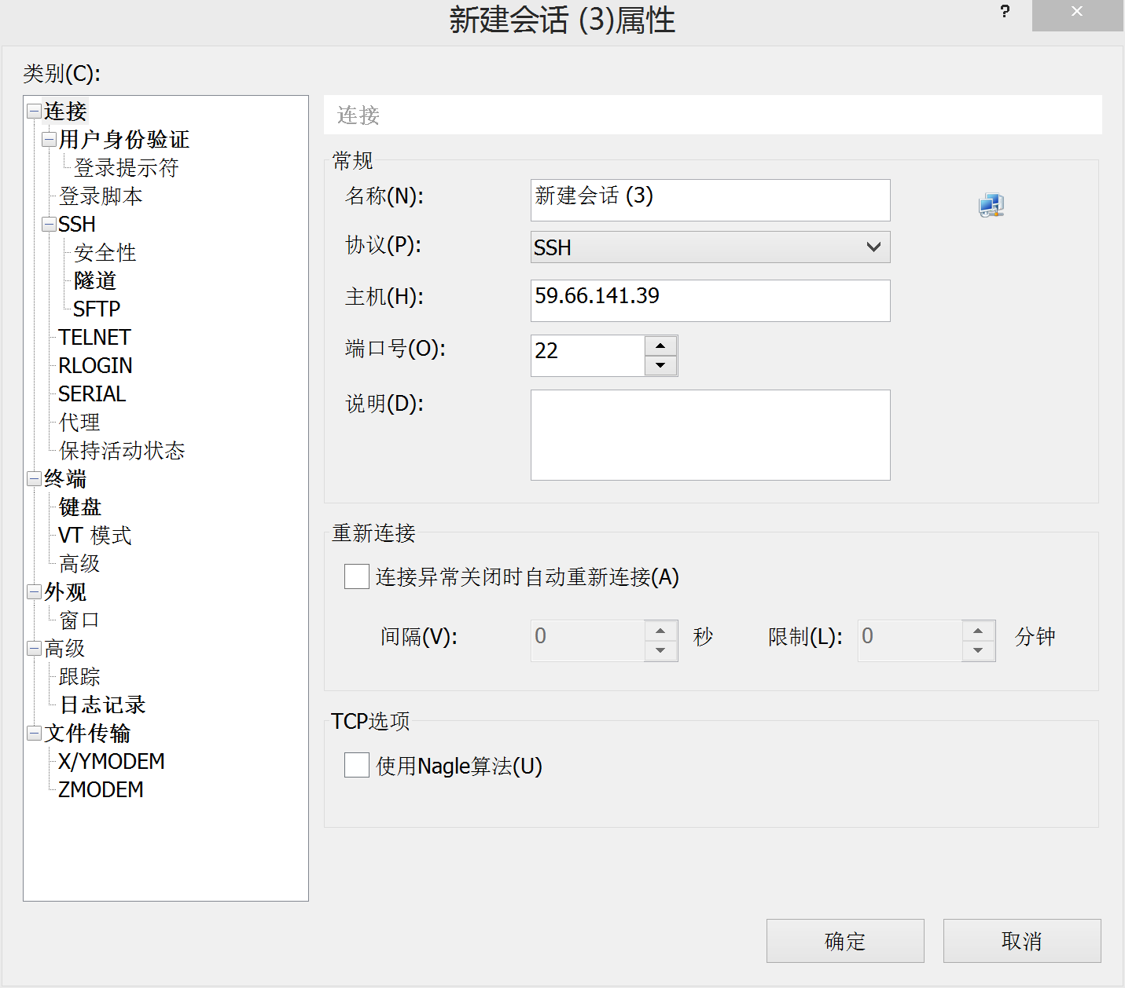
CONNECTING TO A LINUX SYSTEM
Server for learning

Slide 12
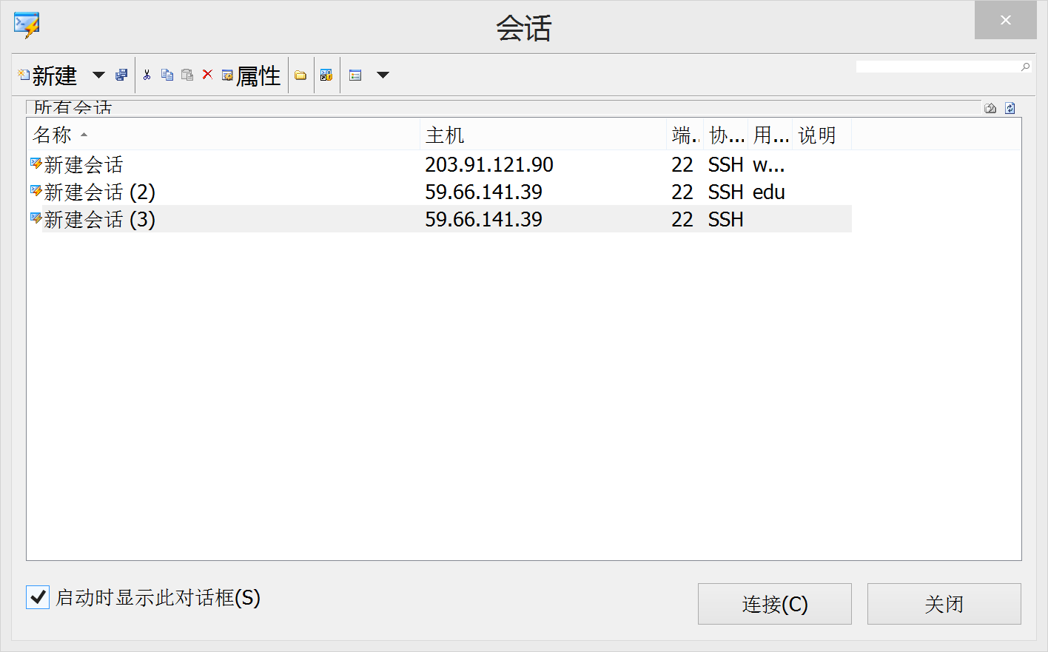
CONNECTING TO A LINUX SYSTEM

Slide 13
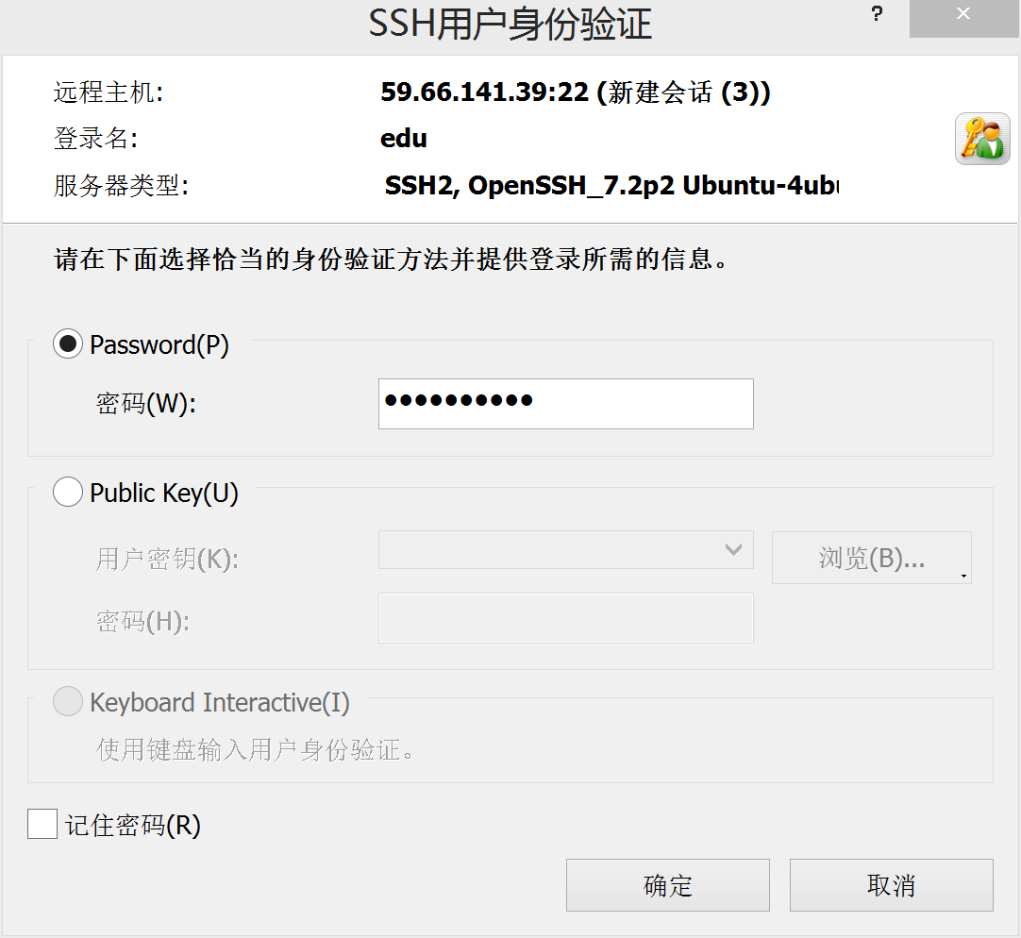
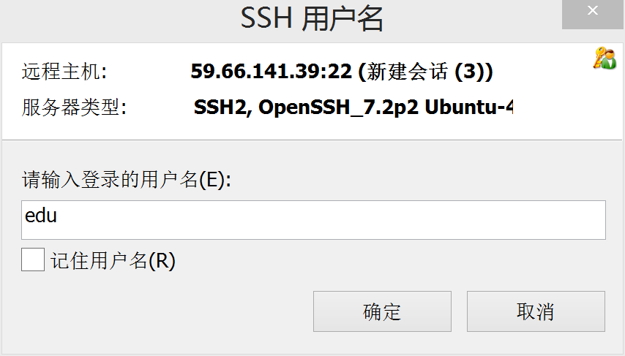
CONNECTING TO A LINUX SYSTEM
Connections with password has poor security.
Safer choice is public key.
But since the environment runs in docker for tutorial, password just ok.
User:edu
Password:edu-eesast

Slide 14
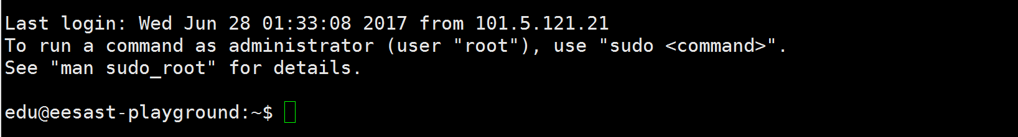
CONNECTING TO A LINUX SYSTEM
Have a try.
• Whenever you need help with a command type “man” and the command name

Slide 15
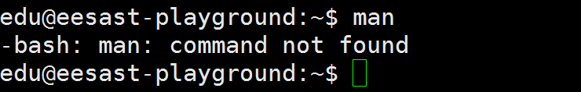
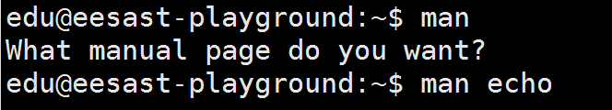
LEARNING TO USE A LINUX SYSTEM
If U see this echo….WHY???
Of course, I have already installed it. You can use “man” directly.

Slide 16
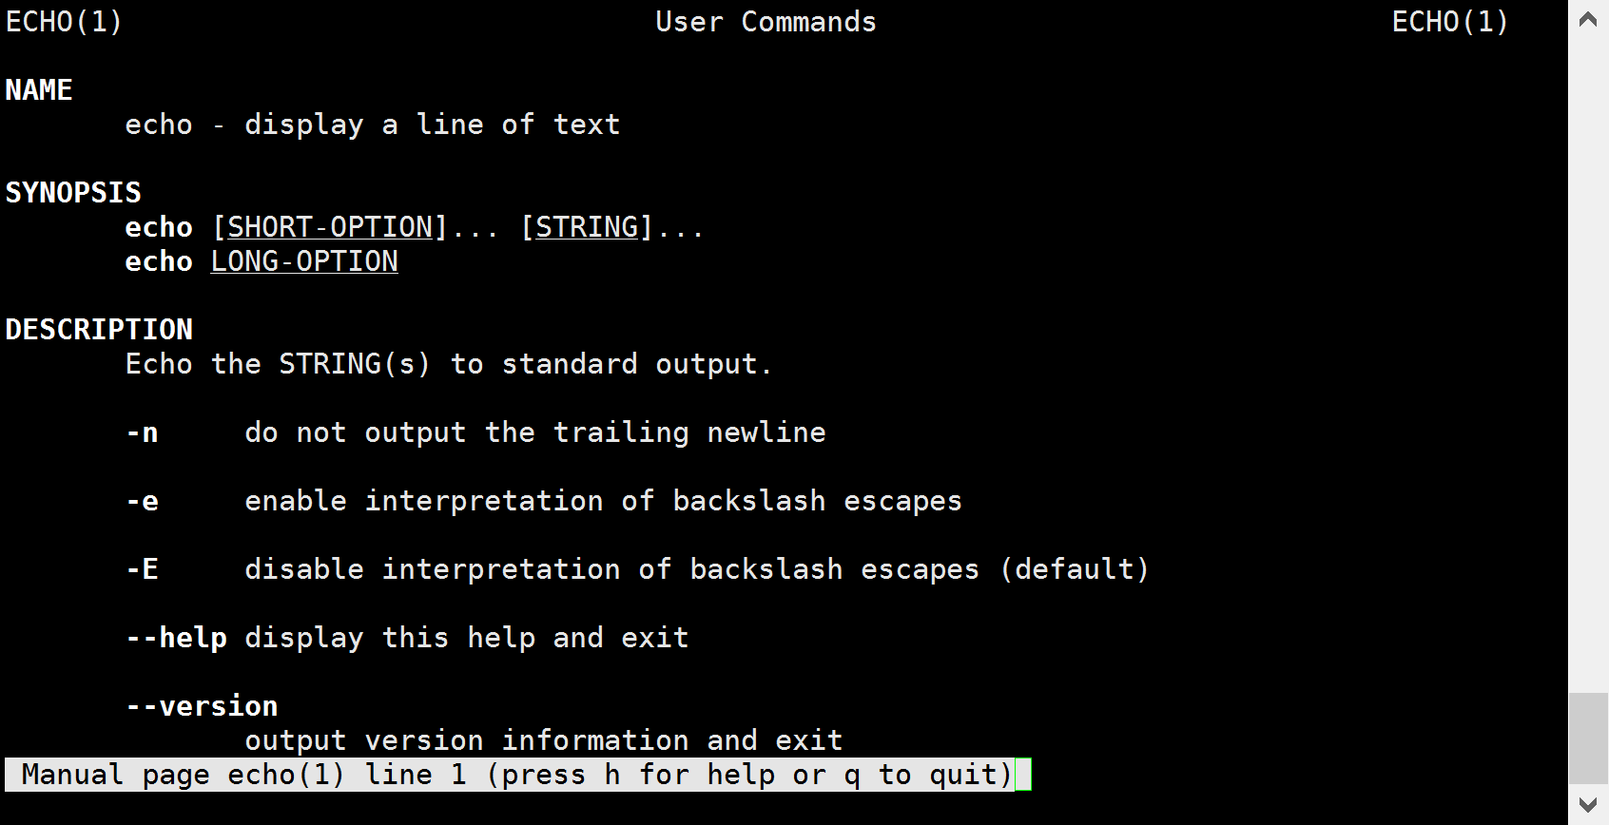
LEARNING TO USE A LINUX SYSTEM

Slide 17
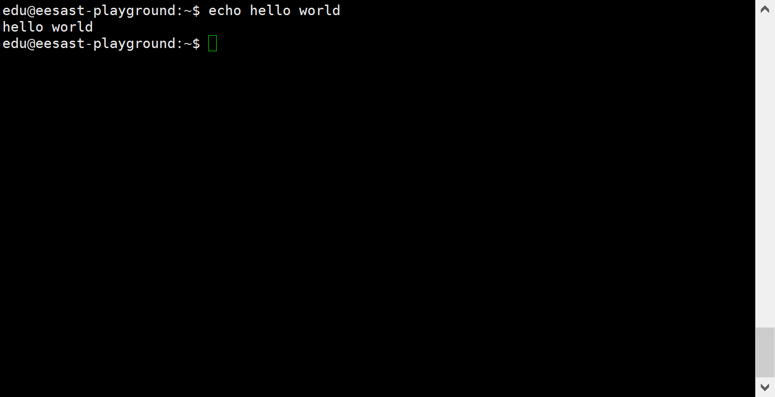
LEARNING TO USE A LINUX SYSTEM

Slide 18
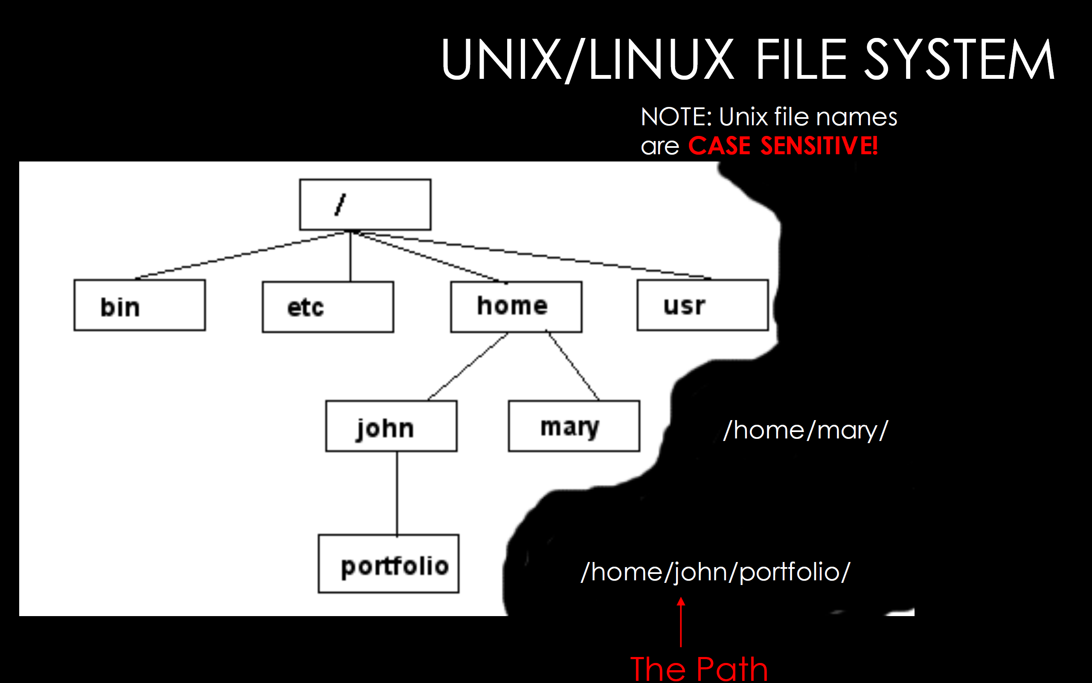
LEARNING TO USE A LINUX SYSTEM

Slide 19
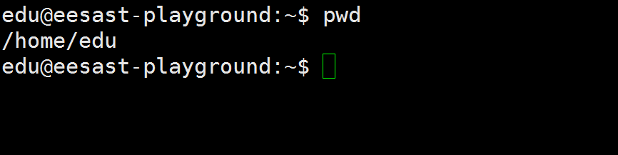
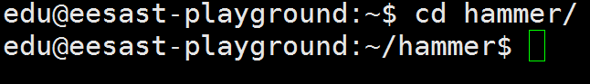
LEARNING TO USE A LINUX SYSTEM
Find current path
To change to a specific directory
“~” is the location of your home directory

Slide 20
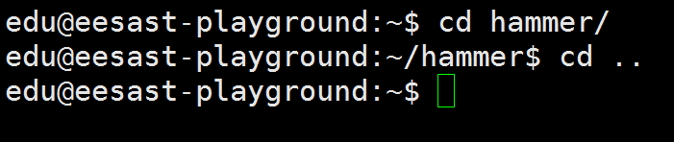
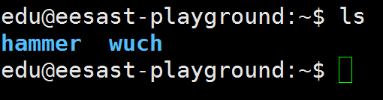
LEARNING TO USE A LINUX SYSTEM
“..” is the location of the directory below current one
To list the files in the current directory

Slide 21
LEARNING TO USE A LINUX SYSTEM
ls has many options
• -l long list (displays lots of info)
• -t sort by modification time
• -S sort by size
• -h list file sizes in human readable format
• -r reverse the order
• “man ls” for more options
• Options can be combined: “ls -ltr”

Slide 22
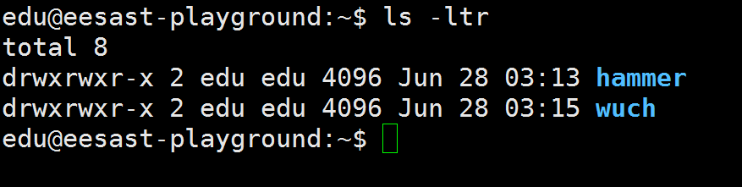
LEARNING TO USE A LINUX SYSTEM
ls has many options
-l long list (displays lots of info)
• -t sort by modification time
• -S sort by size
• -h list file sizes in human readable format
• -r reverse the order
“man ls” for more options
Options can be combined: “ls -ltr”

Slide 23
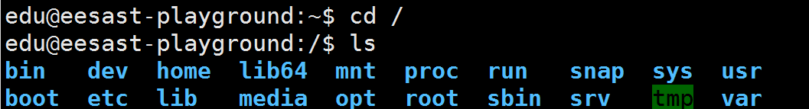
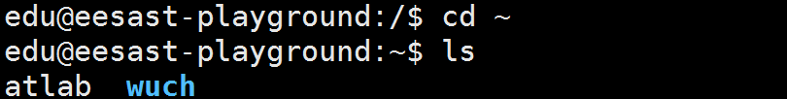
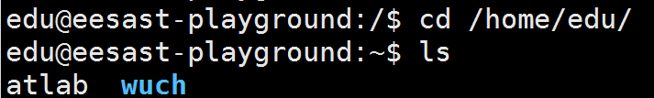
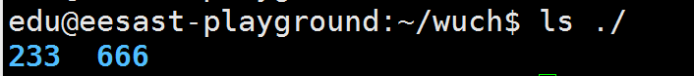
LEARNING TO USE A LINUX SYSTEM
Special directory

Slide 24
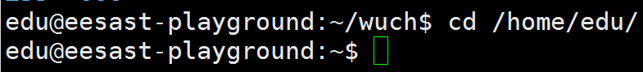
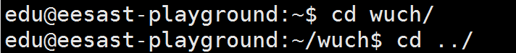
LEARNING TO USE A LINUX SYSTEM
Absolute/Relative path

Slide 25
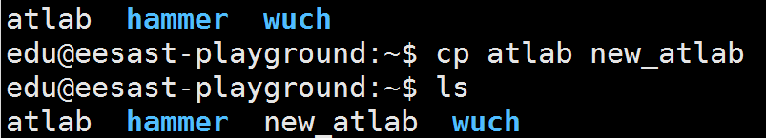
LEARNING TO USE A LINUX SYSTEM
Create a dir named test
Delete a dir named test
Copy

Slide 26
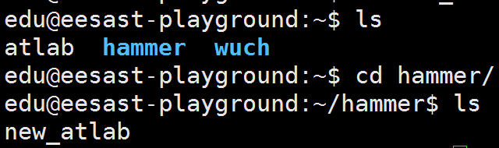
LEARNING TO USE A LINUX SYSTEM
Move
Delete

Slide 27
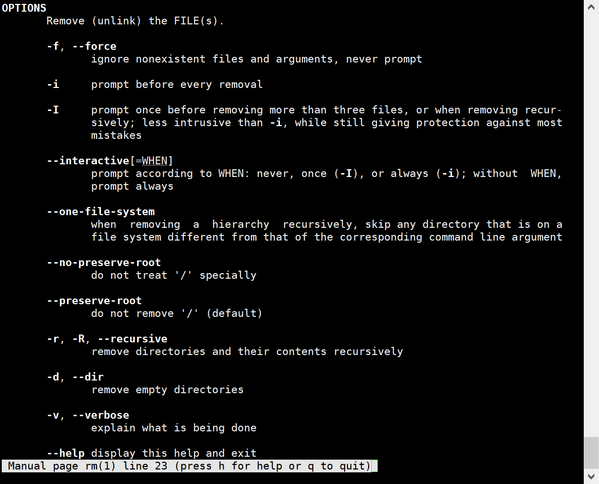
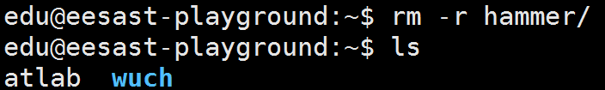
LEARNING TO USE A LINUX SYSTEM
Delete

Slide 28
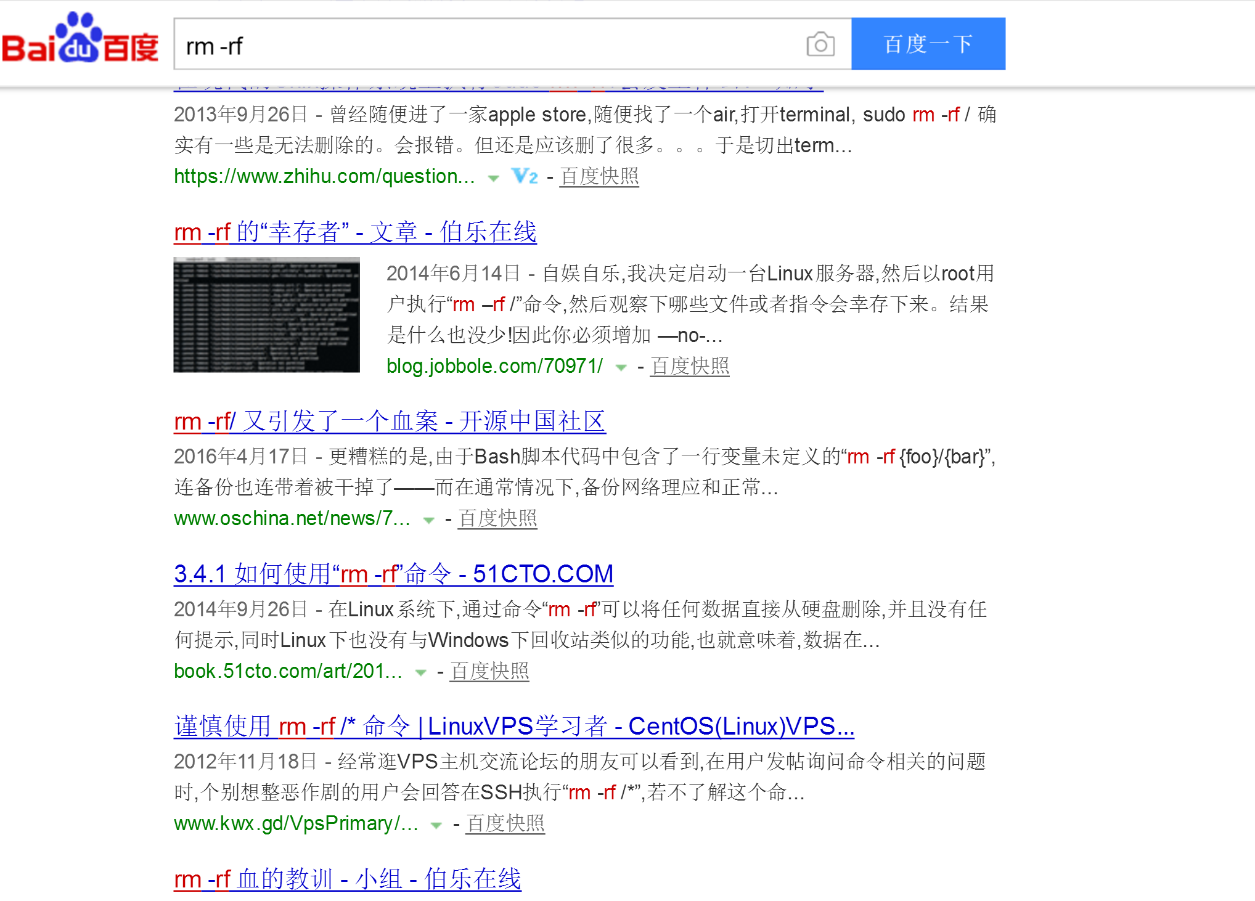
LEARNING TO USE A LINUX SYSTEM
rm –rf /
A catastrophe of delete
Doomsday version : sudo rm –rf /
Think twice before
using rm –rf!!!!

Slide 29
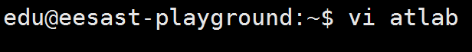
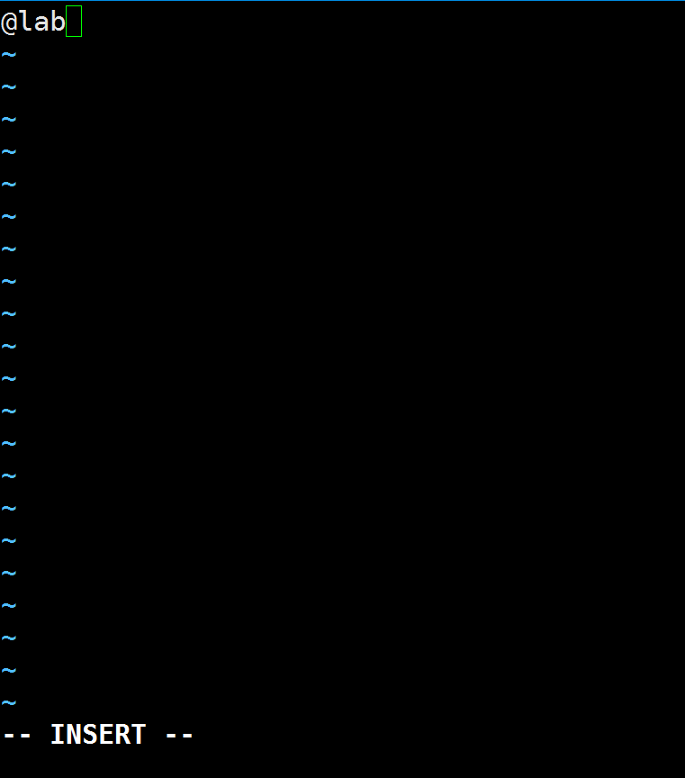
LEARNING TO USE A LINUX SYSTEM
Text edition
Edit the file “atlab” or create a new file
Press “I” to insert and Press Esc to end.

Slide 30

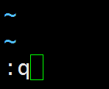
LEARNING TO USE A LINUX SYSTEM
Type “:x” to save and quit.
Type “:q” to quit.(If you don’t make changes, or you will see this)
Type “:q!” to force to quit

Slide 31
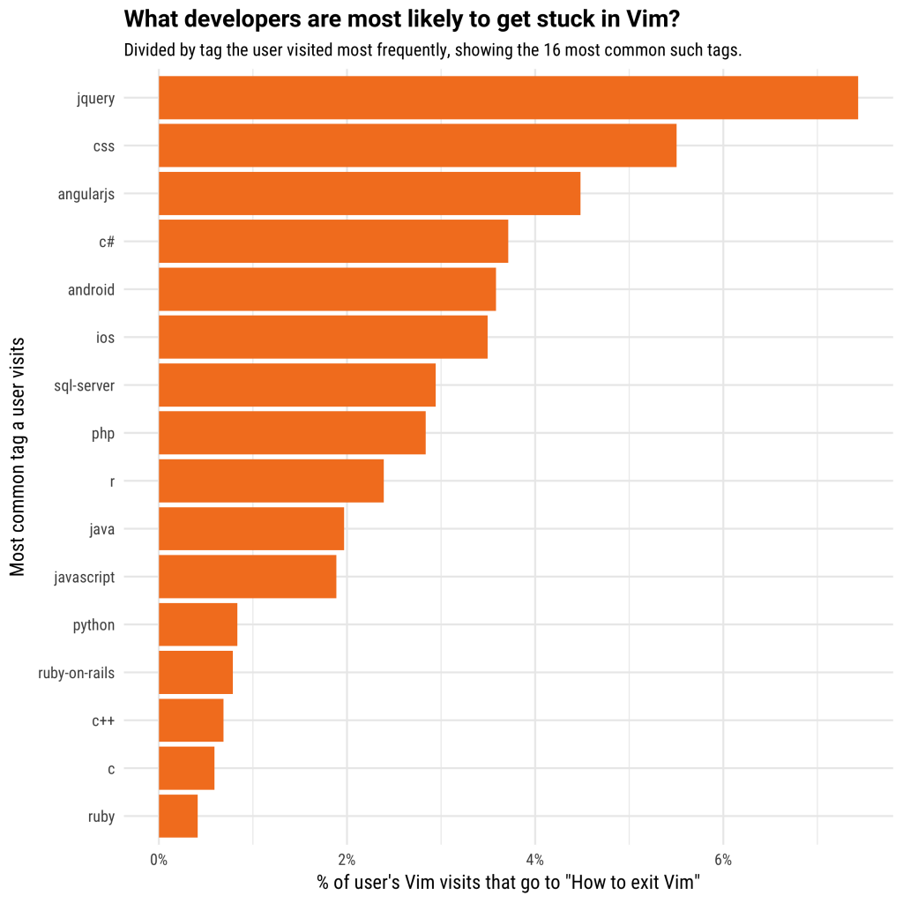
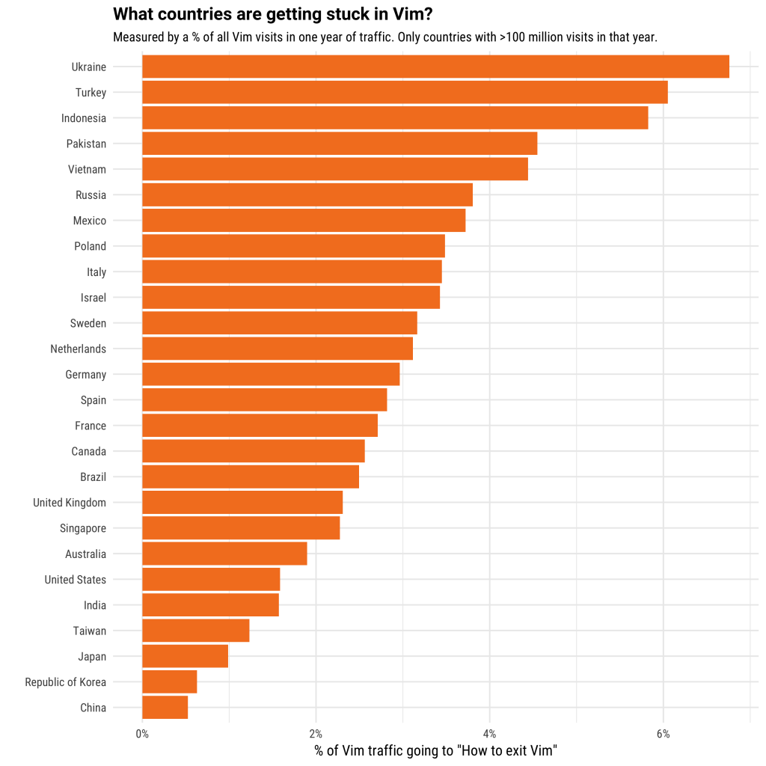
LEARNING TO USE A LINUX SYSTEM

Slide 32
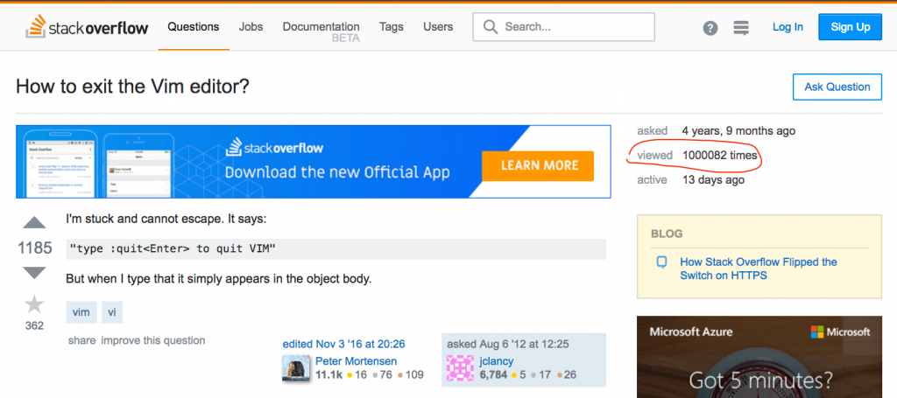
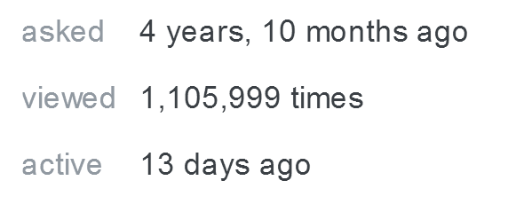
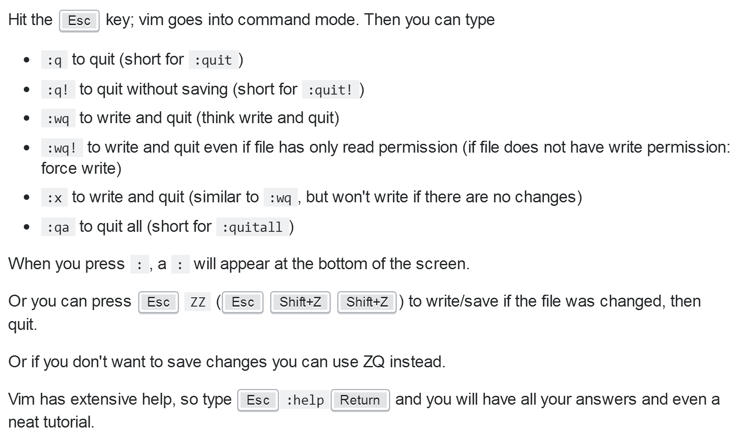
LEARNING TO USE A LINUX SYSTEM

Slide 33
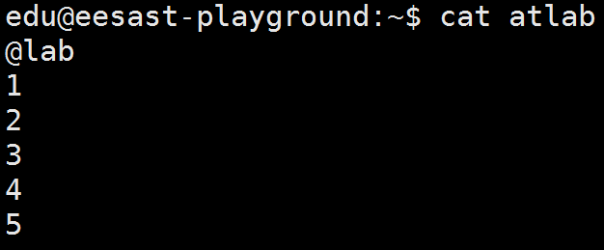
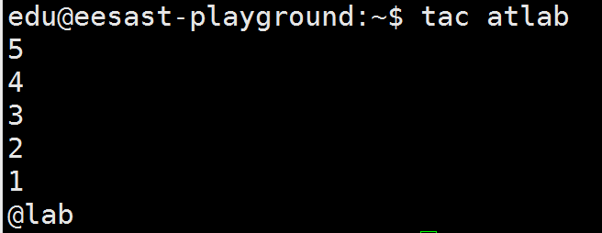
LEARNING TO USE A LINUX SYSTEM
View files :cat tac less more head tail

Slide 34
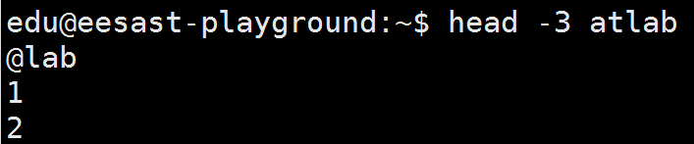
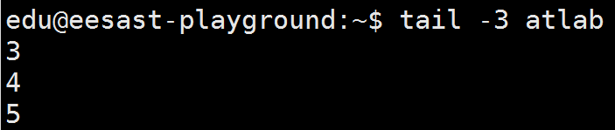
LEARNING TO USE A LINUX SYSTEM
View files :cat tac less more head tail

Slide 35
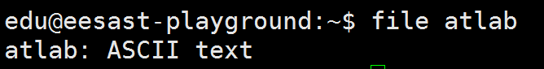
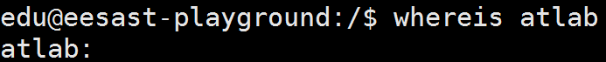
LEARNING TO USE A LINUX SYSTEM
View files type
Find files whereis locate find
Fast, but may not fit for new files.

Slide 36
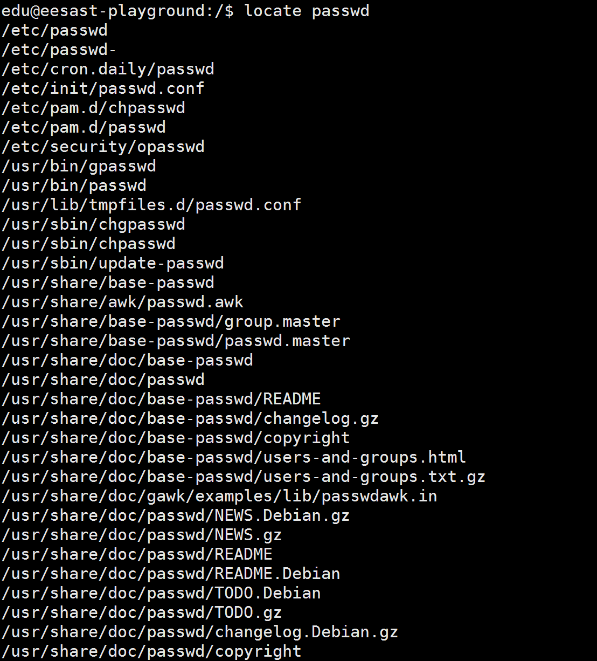
LEARNING TO USE A LINUX SYSTEM

Slide 37
LEARNING TO USE A LINUX SYSTEM
Often used commands (Learn by yourselves)
tar zip unzip
dump dd
top
rz sz

Slide 38
User
User ——For security
• File owner
• User group
• sudoer
• authority(权限)
• authority for file and command

Slide 39
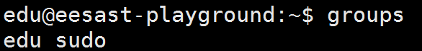
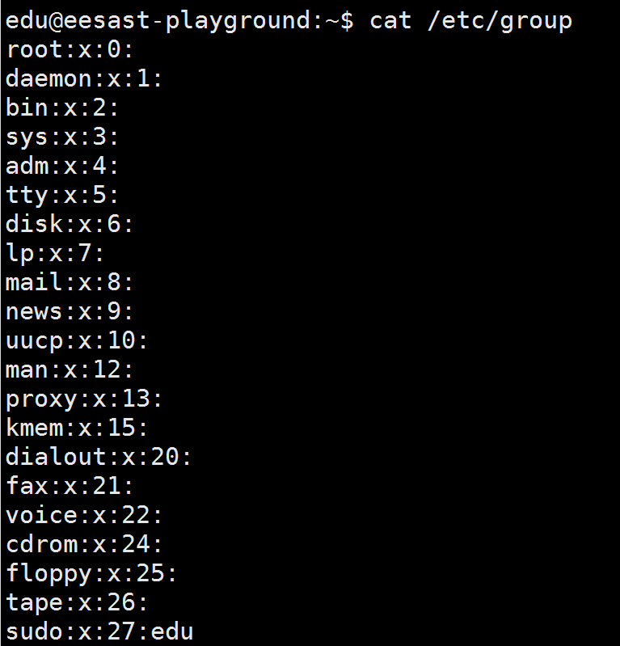
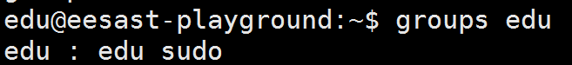
User
User groups
group:group password:GID:users

Slide 40
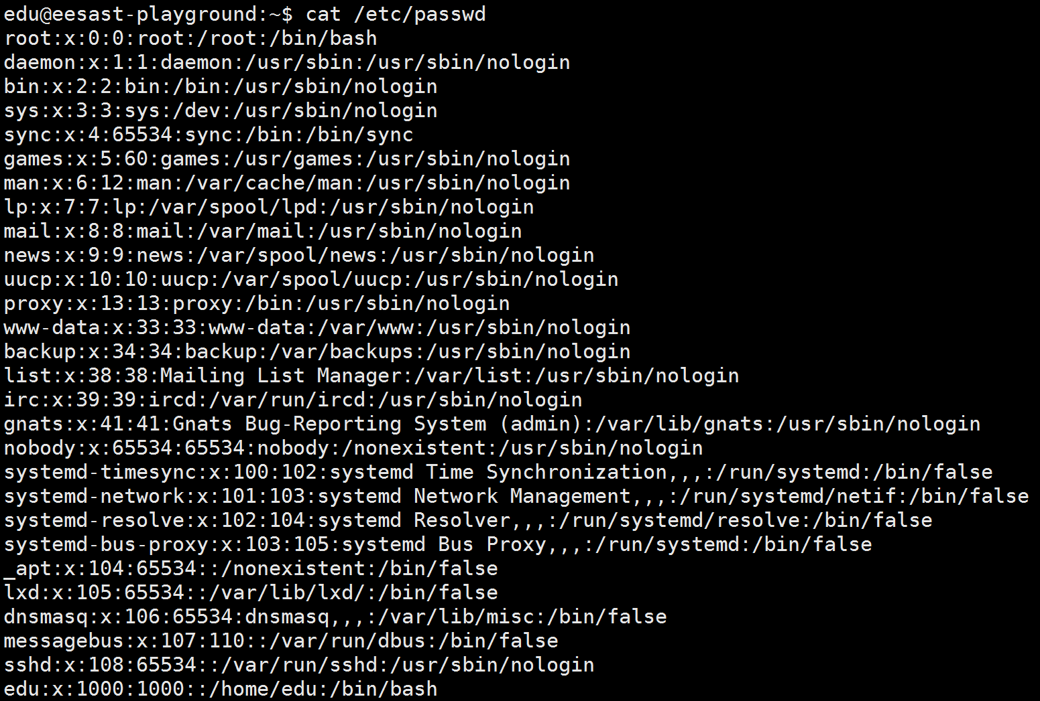
User
Users
user:passwd:UID:GID:comments:home:shell

Slide 41

User
Authority
755 rwxr-xr-x
640 rw-r-----
three numbers:
Authority for owner,
users in the same group,
all users

Slide 42

User
useradd

Slide 43


User
usermod
userdel
Other command: passwd, groupadd, groupdel ….

Slide 44
3
环境配置与操作与人生经验
Mainly about some recommended operations

Slide 45

LEARNING TO USE A LINUX SYSTEM
Environment variables

Slide 46

LEARNING TO USE A LINUX SYSTEM
Install pip
virtualenv for python
pip install virtualenv

Slide 47


LEARNING TO USE A LINUX SYSTEM

Slide 48


LEARNING TO USE A LINUX SYSTEM
How to shut down?
Prepare:

Slide 49

LEARNING TO USE A LINUX SYSTEM
How to shut down?

Slide 50



LEARNING TO USE A LINUX SYSTEM

Slide 51
电子系科协软件部 武楚涵
Thanks!

